Slide 1
HKU Big Data and Privacy Workshop 2015 The Age of Big Data
Dr. Reynold Cheng
Data Engineering Group
HKU Computer Science
ckcheng@cs.hku.hk

Slide 2
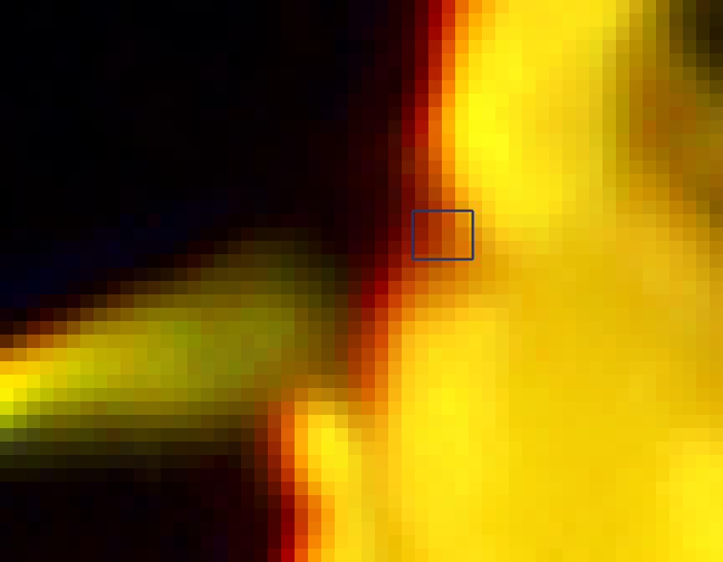

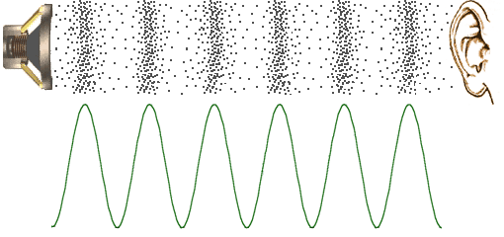
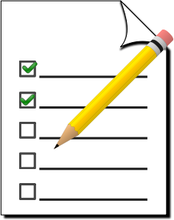
Data
Text
stored word-by-word, character-by-character
Image
A 2D array/matrix of pixels (picture elements)
Audio
Sound wave represented by a sequence of values
Video
a sequence of images + audio
Image source: http://www.mediacollege.com/audio/01/sound-waves.html
Notes:
Sensors for gathering climate information, posts to social media sites, digital pictures and videos, purchase transaction records, and cell phone GPS signals.

Slide 3
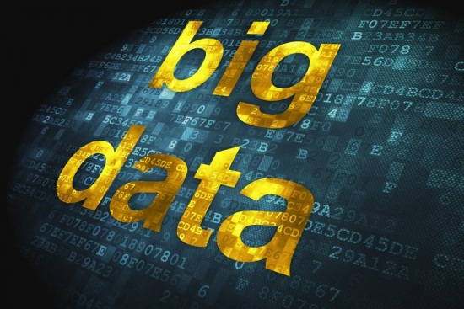
Big Data
“Big data is data that exceeds the processing capacity of conventional database systems.” [4]
“Big data is a collection of data sets so large and complex that it becomes difficult to process using on-hand database management tools or traditional data processing applications.” [1]

Slide 4
The 3 Vs of Big Data
Big Data
Volume
Velocity
Variety

Slide 5
The 3 Vs of Big Data
Big Data
Volume
Velocity
Variety

Slide 6
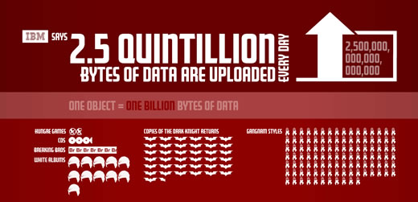
Big Data
Every day, we create 2.5 quintillion bytes of data
90% of the data in the world today has been created in the last two years alone.
Notes:
This data comes from everywhere: sensors for gathering climate information, posts to social media sites, digital pictures and videos, purchase transaction records, and cell phone GPS signals.

Slide 7
The 3 Vs of Big Data
Big Data
Volume
Velocity
Variety

Slide 8
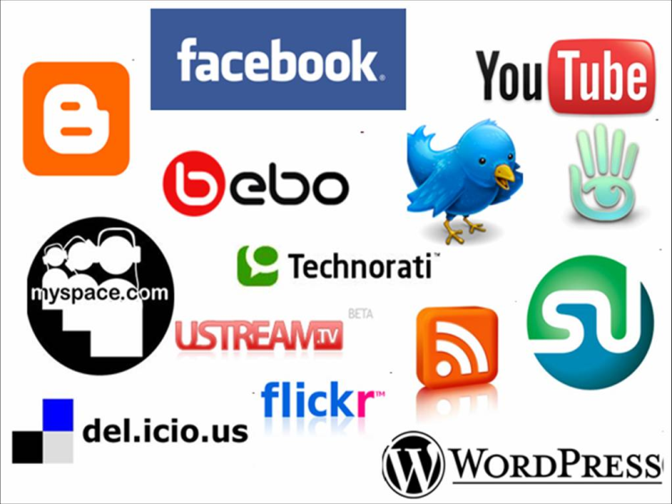
Sources of Big Data
Internet
Crowd sourcing
Wikipedia, forums, answers
Social networks
Facebook, instagram
Microblogs
Twitter
Sensors
Mobile phones, GPS, Camera
Image source: http://avtecmedia.com/images/blog/social-networking-logos.jpg
Notes:
Source data is diverse

Slide 9
The 3 Vs of Big Data
Big Data
Volume
Velocity
Variety

Slide 10


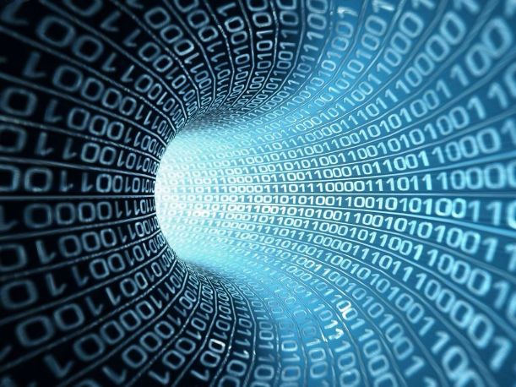

Traffic statistics
Juniper Research estimated that 14.7 trillion mobile messages would be sent from mobile devices in 2012* (i.e. 466,133 messages every second)
* http://www.statista.com/statistics/262005/mobile-message-traffic-worldwide/
Notes:
Data is generated in an increasing rate

Slide 11
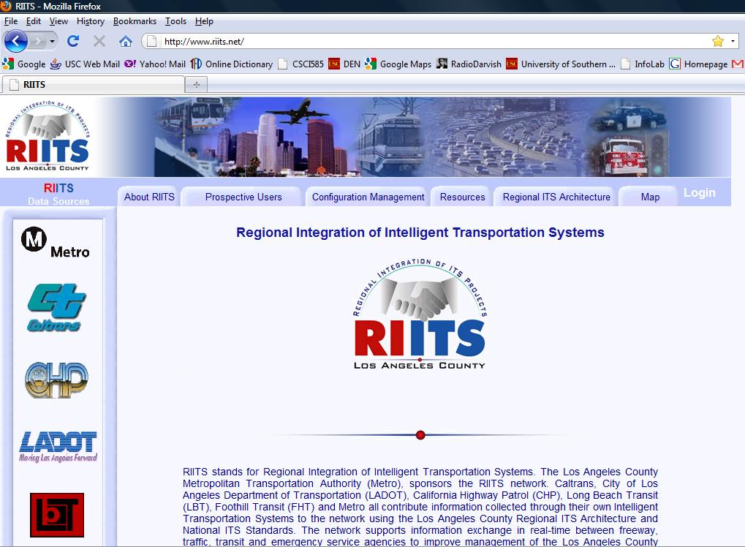
Road Traffic data
“TransDec: A Big-Data Framework for Decision-Making in Transportation Systems” by Prof. Cyrus Shahabi
RIITS (Regional Integration of Intelligent
Transportation Systems)http://www.riits.net/
Collects data from Los Angeles

Slide 12
Traffic data
Variety (GPS, video, loop sensor, events)
Velocity
Volume
Notes:
BUS_MTA_XX: Bus locations
CCTV_XX : Camera snapshots
CMS_XX: Emergency data (ambulance, fire etc)
EVENT_XX: Event data (it must be incidents and etc)
RAIL _XX: Train location data
RMS_XX: Not sure
SIGNAL_XX: Not sure
VDS_FR_D7_RT: Freeway traffic sensor data
VDS_ART_LADOT_RT: Arterial traffic sensor data

Slide 13
Big Data Applications
Discover insights for science, healthcare, government, vehicle traffic control, private sectors, and international development.
Image source: www.business2community.com

Slide 14
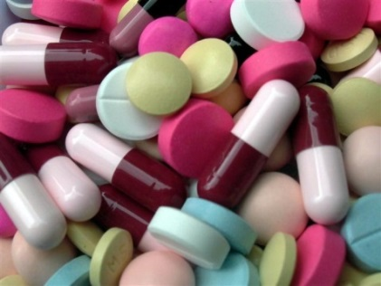
Drug data analysis
Pharmaceutical companies used the big data for more tangible results such as drug testing [1].
Based on predictive analysis, drug companies can focus on the consumers most likely to benefit from their products [39].
Image source: www.business2community.com

Slide 15

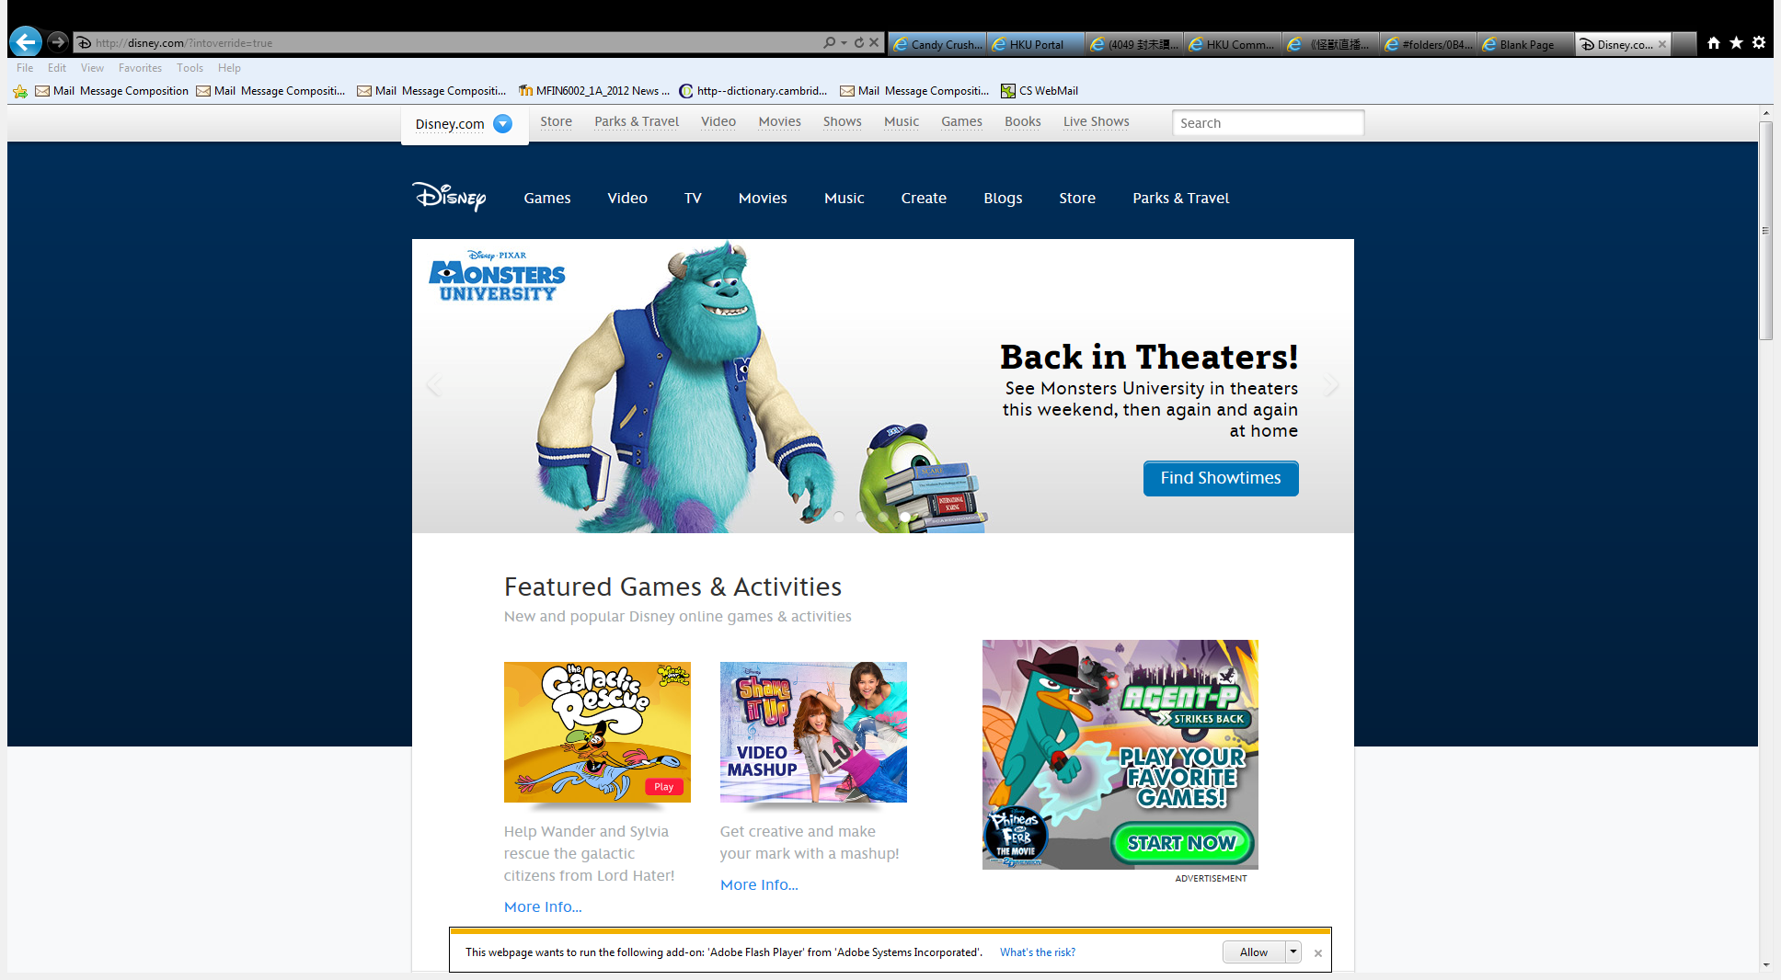
Customer data analysis
Walt Disney Company used the big data “to correlate and understand customer behavior in all of its stores, theme parks and web properties.” [1]
Every year, there are about 100 million visitors visited Disney parks.
Walt Disney collects visitor data by a wireless-tracking wristband “MagicBand”:
visitors information, purchase history, location, etc.
Helps Walt Disney to make better decisions, to improve its offerings and tailor its marketing messages. [38]
Image source: disney.wikia.com

Slide 16
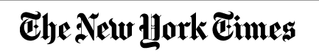
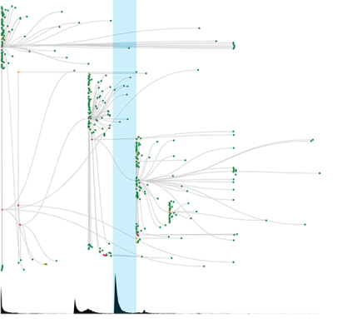
Text data analysis
New York Times used big data for text analysis and web mining [1].
Cascade project use the browsing logs to understand and predict when an online conversation will result in a tidal wave of content consumption on the Times. [40]
This helps to understand the users’ needs and interests to improve their marketing strategy.

Slide 17
Applications of Big Data
The Apple Siri learns by collecting information from iPhones
“Google Now” reminds you of your next flight automatically by analyzing your web activity.
Notes:
This era of “information burst” has brought convenience to our daily lives.
What other convenience can you think about?
When analyze that you go to the church every Sunday morning, it shows you the real time traffic information to the church on every Sunday morning.

Slide 18
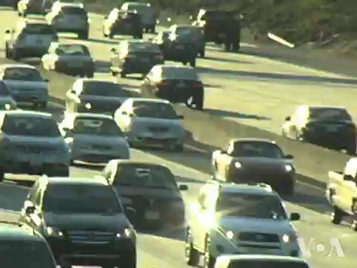
Adapted from “TransDec: A Big-Data Framework for Decision-Making in Transportation Systems” by Prof. Cyrus Shahabi

Slide 19
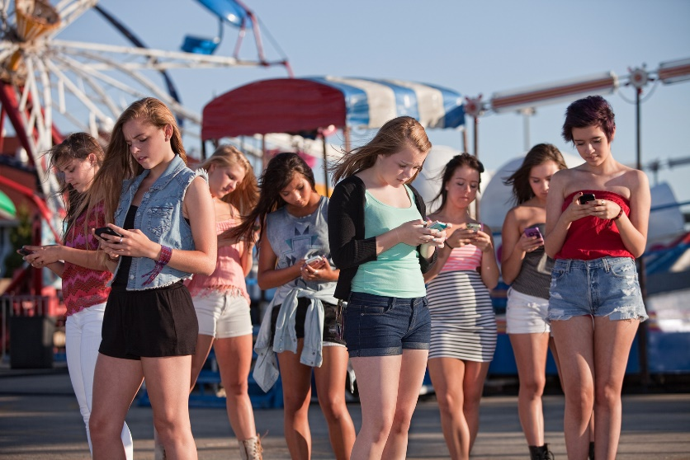
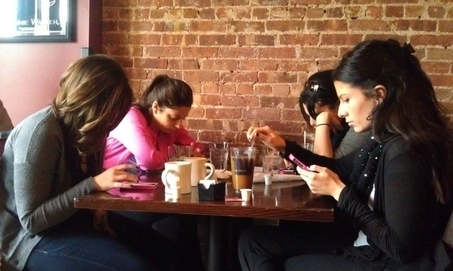
Impact on society
Image source: www.ohmygeek.net , www.buzzfeed.com
Notes:
Big Data has created new questions on social and moral values.
Can third-party companies use Facebook contents to perform advertisement?
Is it right or wrong for a government to monitor and collect data from her citizens?
What is the impact on our life since we start using IM software?

Slide 20
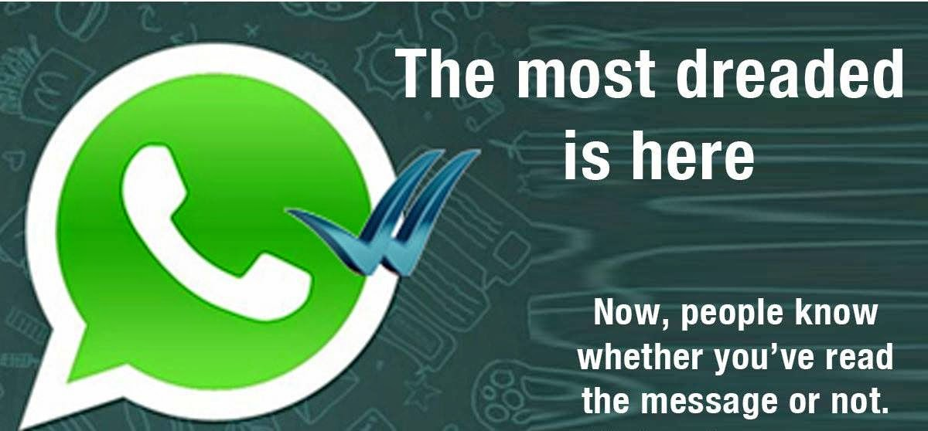
Impact on society
Image source: www.makemeentertain.com
Notes:
Recently introduced feature in Whatsapp:
Tracking ‘read’ status of messages
http://hku.iclass.hk/join/UI5534

Slide 21
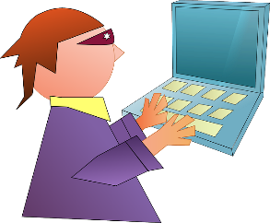
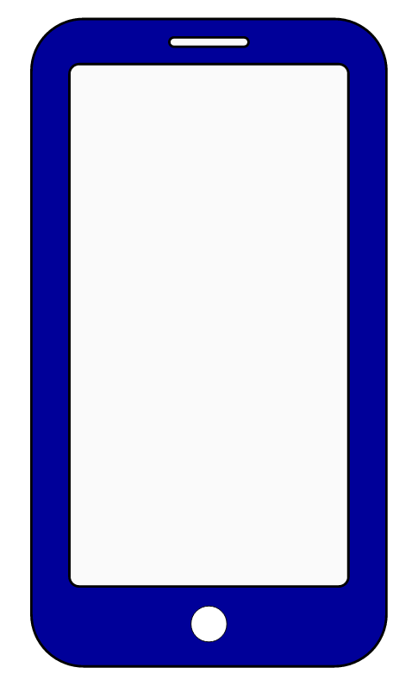
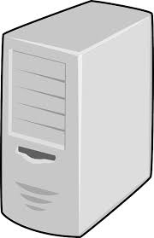


Security & Data Protection
Until August 2012, messages sent via Whatsapp were sent as plaintext
Internet

Slide 22
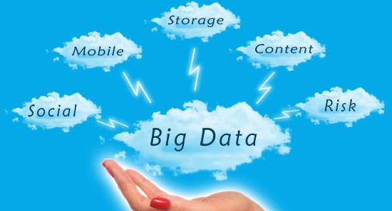
Privacy
Is it ethical for Google to analyze your web activity, including your email, to know that you have bought a ticket?
Leakage of private data, due to the use of the Foxy software, and the loss of USB drives that contain thousands of patients’ records, have also raised serious legal and social concerns.
Can sensitive data be released to public?
Image source: http://www.tnooz.com/2013/04/27/news/for-opprtunities-as-a-startup-look-no-further-than-big-data/
Notes:
The availability of such a vast amount of information has also created problems.
How does the parent know that the information written on the micro blogs is correct?
It is ethical for Google to analyze your web activity, including your email, to know that you have bought a ticket, so that it can remind you of the flight information later on?
Leaking of criminal records, patient files, or sensitive photos can cause serious privacy problems
Can sensitive data be released to public?

Slide 23
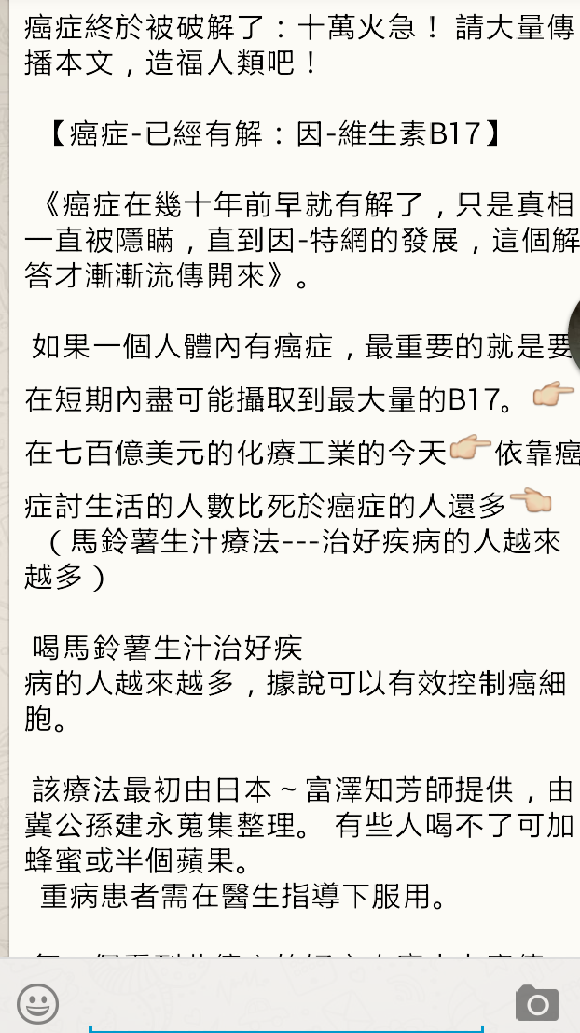
Credibility
Have you ever received false messages from friends?
If we believe in rumors, false decisions can be made
Notes:
The creation of voluminous amount of data around us (e.g., microblogs, Wikipedia) raises the issue of trust
If we believe in false information or rumors, false decisions can be made
Consider the earthquake news in Japan and China’s reaction to it

Slide 24
Organizing and exploring Big Data
How does Whatsapp organize data?
Users
Groups
Messages
Attachments
Are cloud computing technologies adequate?
Notes:
1. What is your academic background?
Architecture
Arts
Business and Economics
Dentistry
Education
Engineering
Law
Medicine
Science
Social Science
Do you like instant messaging software?
Yes
Neutral
No

Slide 25
Organizing and exploring big data
How to organize and retrieve useful information from Big Data in a timely fashion?
How to locate the information I need to meet a survey project deadline?
How does the FBI find the suspects of the Boston bombings (April 2013) through crowdsourcing?
How to organize and search my personal data?

Slide 26
References
[1] Big data. Wikipedia. URL: http://en.wikipedia.org/wiki/Big_data
[2] How Much Information? University of California, San Diego. URL: http://hmi.ucsd.edu/howmuchinfo.php
[3] IBM DB2. URL: http://www.ibm.com/software/data
[4] Big Data Now: 2012 Edition from O’Rielly Media, Inc.
[5] IBM. URL: http://www-01.ibm.com/software/data/bigdata/
[6] Big data Analytics: Turning Big Data into Big Money. Frank Ohlhorst. John Wiley & Sons, Inc. 2013.
[7] Moore’s law. Wikipedia. URL: http://en.wikipedia.org/wiki/Moore's_law
[8] Hadoop. URL: http://hadoop.apache.org/

Slide 27
Thank you!
Reynold Cheng
Data Engineering Group
Computer Science, HKU
http://www.cs.hku.hk/~ckcheng/
ckcheng@cs.hku.hk

